Slide 1
Student Information System
SUSHANTH.P
MEGHANA.B
MANEESHA.P
NAZMA BEGUM
VIDHYA ANNAPURNA.P

Slide 2
INDEX
INTRODUCTION
FEATURES
FLOW CHART
FLOW OF THE PROJECT
LANGUAGES USED
SOFTWARE AND HARDWARE REQUIREMENTS
USER REQUIREMENTS
LIMITATIONS
CONCLUSION

Slide 3
INTRODUCTION
OVERVIEW :
The Student Information System Software is an application that permits you to compare, manipulate and present student data in a meaningful manner generating a clever view of records and provides search facilities with various search options.

Slide 4
FEATURES
The Student Information System empowers you to:
Manage Student Information efficiently.
Record Student Billing details like name , roll- no., course , stream, semester , date of birth , father’s name , address , phone no., email id , etc.
Add, Update & Delete Students information easily.
Manage your own Security by providing authorized user name & passwords.

Slide 5
Cont….
STUDENT DETAILS: To maintain all the accounts of the students in digital form from enrollment up to the end of the study.
LOGIN PAGE: To provide login page for the students to log into the home page.

Slide 6
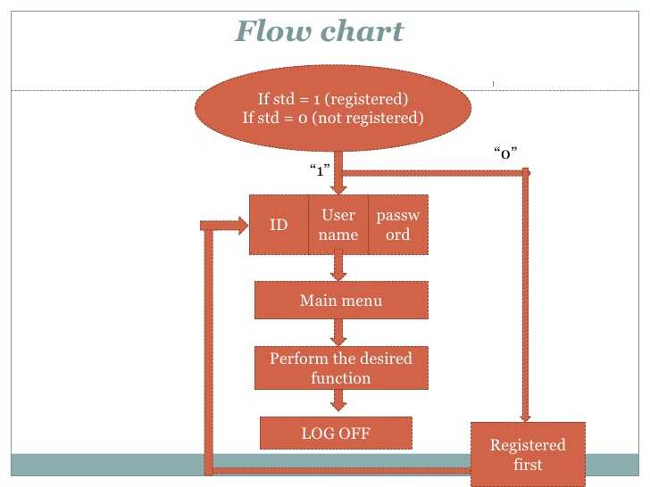

Slide 7
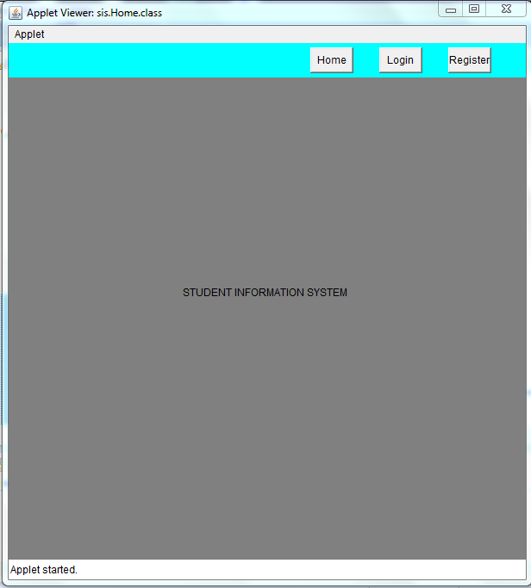
HOME PAGE

Slide 8
REGISTRATION PAGES
REGISTRATION : To provide registrations for the students like….
1.Student Registration Form
2. Course Registration Form
3. Exam Registration Form

Slide 9
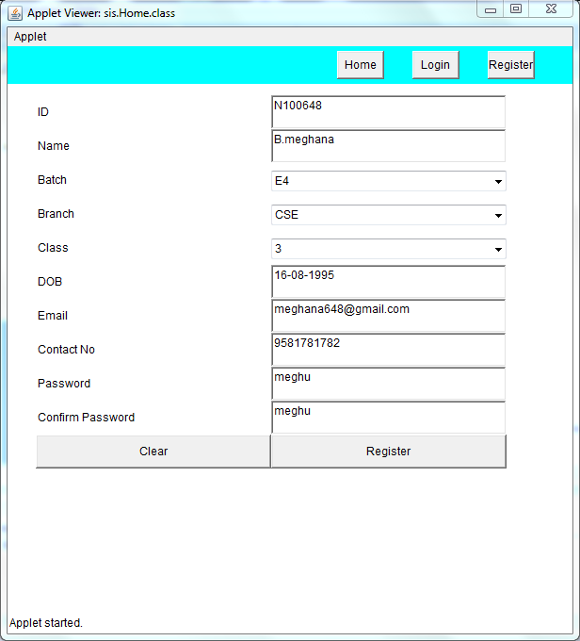
STUDENT REGISTRATION FORM

Slide 10
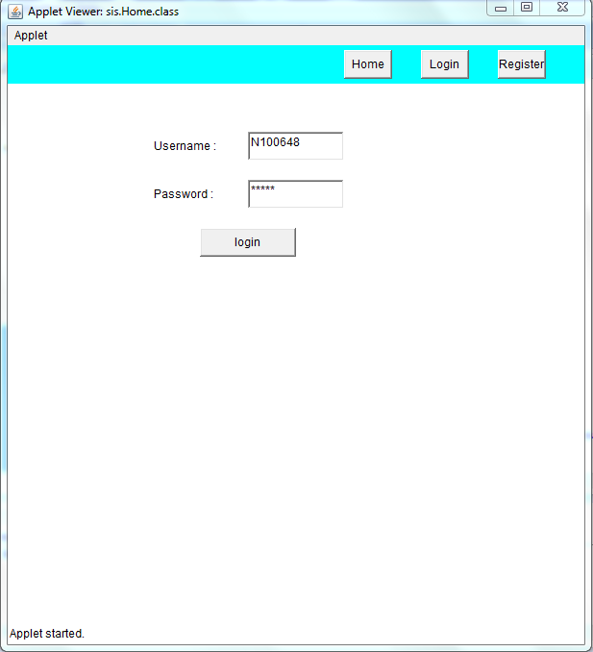
LOGIN PAGE

Slide 11
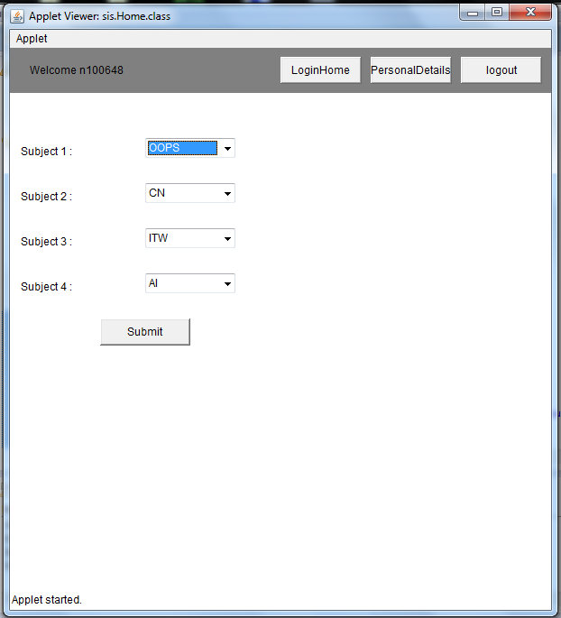
COURSE REGISTRATION

Slide 12
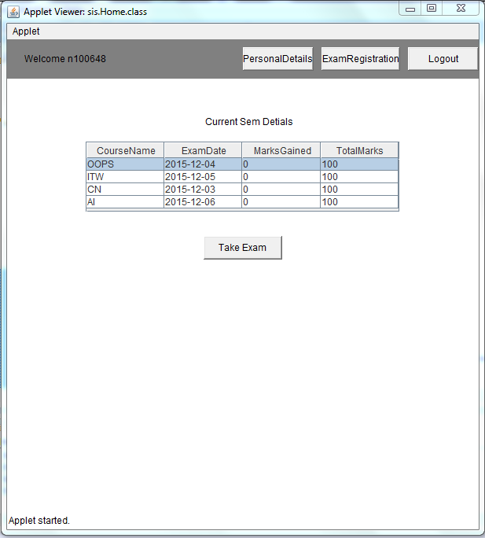
EXAM REGISTRATION FORM

Slide 13
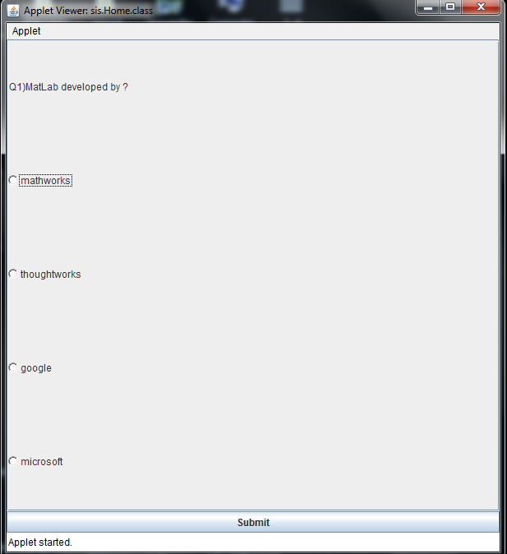
EXAM FOR COURSES

Slide 14
LANGUAGES USED
Java Applets
DBMS: Database Management System
MySql

Slide 15
Software & Hardware requirements
Hardware requirements:
Processor : Intel core i3
Processor Speed : 250MHz to 833MHz
RAM : 4 GB RAM
Hard Disk : 100GB
Software requirements:
Operating System : Windows 7/Windows 8
Java JRE-8 JDK-8
Eclipse (kepler version)
Xampp Server
JDBC( Java Database Connection)Components

Slide 16
USER REQUIREMENTS
User has to register with the system for using all the facilities available in the system.
Student can write the exams which he/she registered.
Student has to login with his id number, which is assigned by the system.
Student can create his/her own password to login into home page.
It will display student profiles.

Slide 17
LIMITATIONS
Not for mobile user.

Slide 18
CONCLUSION
Normally conventional system we use maximum manual applications. It consumes lots of time and paper. But this system totally Java Applets, it means that student can enter into the system very easily. This system is totally user friendly and time saving and cost effective system.

Slide 19
REFERENCES
Web Sites
www.w3schools.com
www.wikipedia.com
Search Engine
www.google.com

Slide 20


